Slide 1
Lecture 1
Note: Some slides and/or pictures are adapted from Lecture slides / Books of
Dr Zafar Alvi.
Text Book - Aritificial Intelligence Illuminated by Ben Coppin, Narosa Publishers.
Ref Books
Artificial Intelligence- Structures & Strategies for Complex Problem Solving by George F. Luger, 4th edition, Pearson Education.
Artificial Intelligence A Modern Approach by Stuart Russell & Peter Norvig.
Artificial Intelligence, Third Edition by Patrick Henry Winston

Slide 2
Outline
Course overview
What is Intelligence?
What is AI?
Weak AI vs Strong AI
History
Application
AI languages

Slide 3
What is Intelligence?
How can we define Intelligence?
Is it something tangible?
Consider the image on next slide where a mouse is trying to search a maze in order to find its way from the bottom left to the piece of cheese in the top right corner of the image.

Slide 4
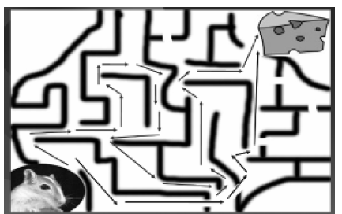
What is Intelligence?

Slide 5
What is Intelligence?
The mouse tries various paths as shown by arrows and can reach the cheese by more than one path.
In other words the mouse can find more than one solutions to this problem.
The mouse was intelligent enough to find a solution to the problem at hand.
Hence the ability of problem solving demonstrates intelligence..

Slide 6
What is Intelligence?
Consider the sequence of numbers below:
1, 3, 7, 13, 21, ___.
Example of Automated Timetable Generation
the ability to think, plan and schedule demonstrate intelligence

Slide 7
What is Intelligence?
Correct and efficient memory and information manipulation (doctor & patient)
Ability to tackle ambiguous and fuzzy problems (height of person i.e tall)
Ability to learn and recognize
Ability to understand and perceive

Slide 8
What is Artificial Intelligence (AI)?
Views of AI fall into four categories:
Thinking humanly Thinking rationally
Acting humanly Acting rationally
A system is rational if it does the “right thing”, given what it knows.

Slide 9
What is AI?
Thinking humanly | Thinking rationally
1. “The exciting new effort to make computers think … machines with minds, in the full and literal sense” (Haugeland, 1985) 2. “[The automation of] activities that we associate with human thinking, activities such as decision making, problem solving, learning …” (Bellman, 1978) | 1. “The study of mental faculties through the use of computational models” (Charniak and McDermott) 2. “The study of computation that make it possible to perceive reason and act” (Winston 1992)
Acting humanly | Acting rationally
1. “The art of creating machines that perform functions that require intelligence when performed by people” (Kurzweil 1990) 2. “The study of how to make computers do things at which, at the moment, people are better” (Rich and Knight, 1991) | 1. “Computational Intelligence is the study of the design of intelligent agents.” (Poole et al., 1998) 2. “AI . . . Is concerned with intelligent behaviour in artifacts.” (Nilsson, 1998)

Slide 10
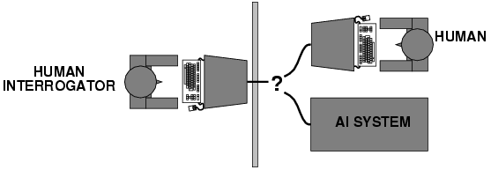
Acting humanly: Turing Test
The computer would need to possess the following capabilities:
Natural Language Processing (to enable it to communicate successfully in english)
Knowledge representation (to store what it knows or hears)
Automated reasoning (to use the stored information to answer questions and to draw new conclusions)
Machine learning (to adapt to new circumstances and to detect and extrapolate patterns)
Computer vision (to perceive objects)
Robotics (to manipulate objects and move about)

Slide 11
Weak AI Versus Strong AI
Schools of Thought
As discussed earlier, AI is considered to be an effort to try to simulate human behavior. But, the need is to define up to what extent the computer can demonstrate the simulation, raising the idea of strong AI and weak AI

Slide 12
Weak AI Versus Strong AI
Strong AI: The followers of strong AI believe that by giving a computer program sufficient processing power, and by providing it with enough intelligence, one can create a computer that can literally think and is conscious in the same way that a human is conscious.
Weak AI: Weak AI, in contrast, is simply the view that intelligent behavior can be modeled and used by computers to solve complex problems.
This point of view argues that just because a computer behaves intelligently does not prove that it is actually intelligent in the way that a human is

Slide 13
AI Programming Language
Prolog
LISP

Slide 14
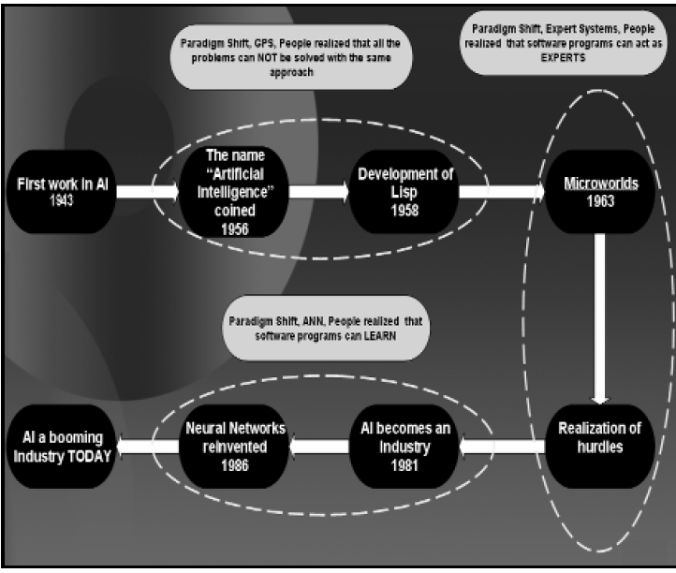
History and Evolution

Slide 15
Applications
Information Retrieval System
Robotic
Games
NLP
Computer Vision
etc

